Slide 1
Cross-node Memory as a Linux Storage Tier：Exploring POSIX-based Shared Memory
Yifan Qiao
qiaoyifan4@huawei.com

Slide 2
Content
Motivation
Design
Prototype
Future

Slide 3
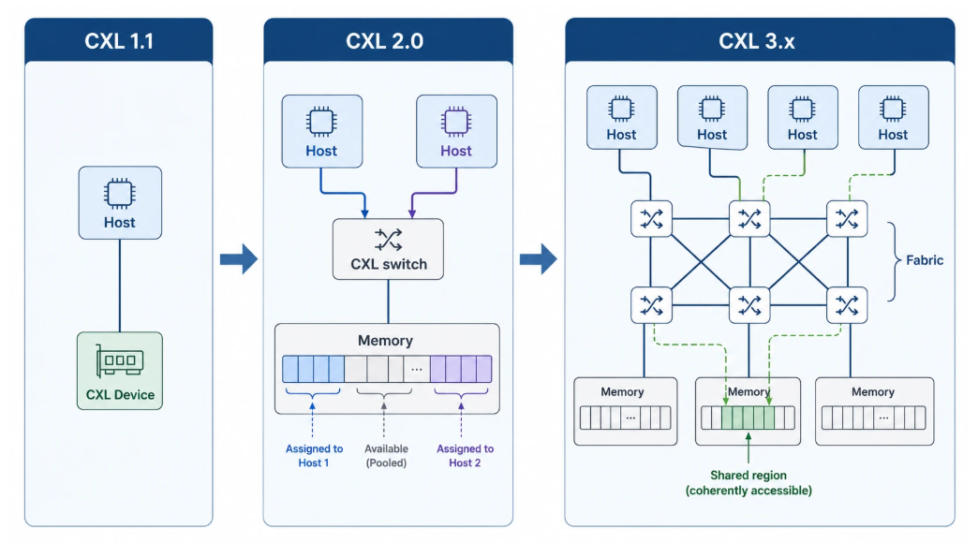
CXL 3.0 pooling & sharing
CXL went from point-to-point, to switched pooling, to a fabric that can share memory.

Slide 4
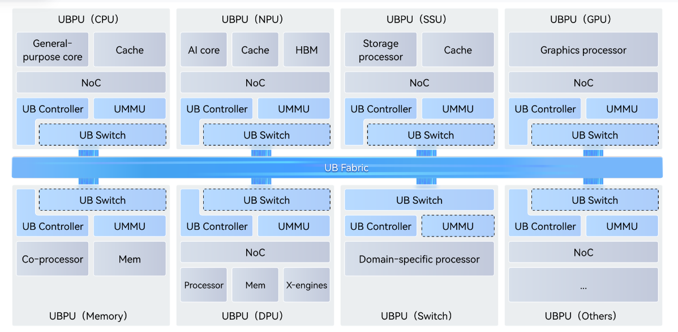
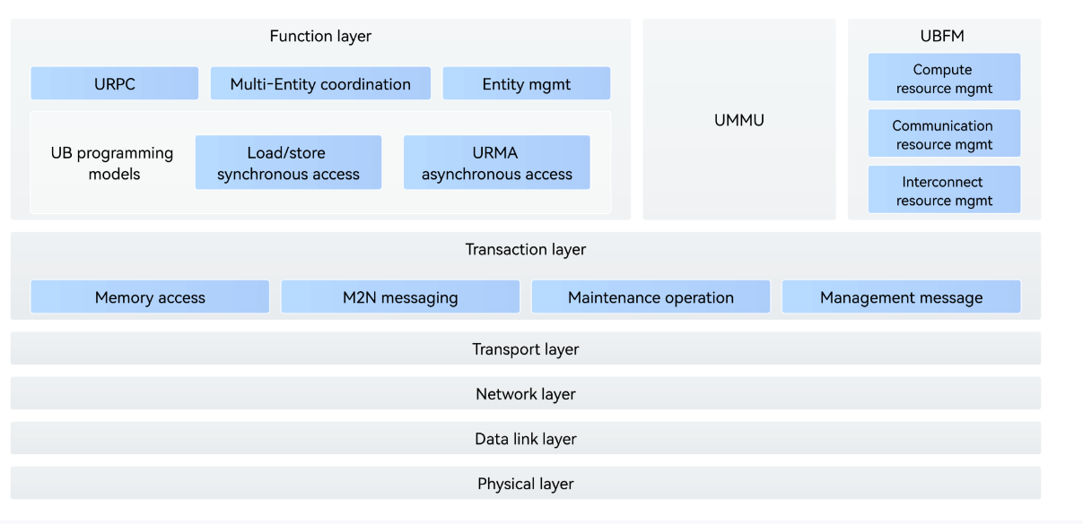
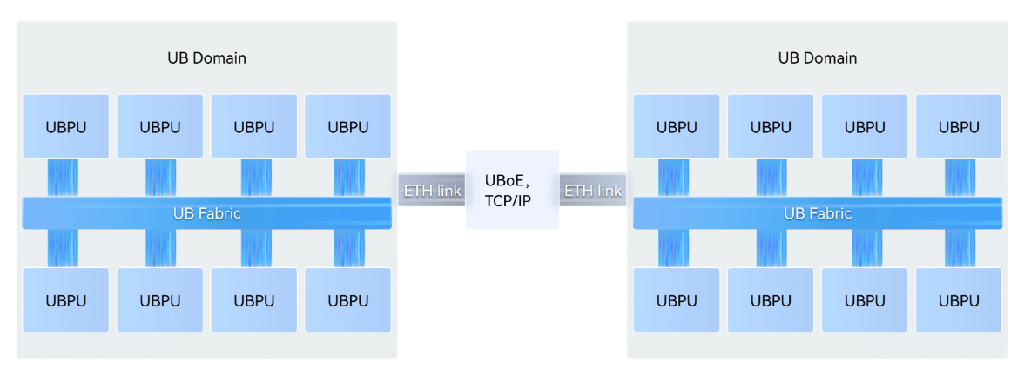
UB mesh
UB domain
UB protocol stack
Unified Bus Sepc: https://www.unifiedbus.com/en
UBRT: https://www.unifiedbus.com/static/UB-Root-Table-Spec-1.0-en.pdf
Cross-UB domain

Slide 5
Memory pooling and sharing today
CXL
remote DRAM becomes byte-addressable
memory semantic ld/st + optional network semantic
memory sharing usually assuming hardware CC
UB
1. treat it as slow RAM: NUMA, memory tiering, CXL-as-RAM
need hardware CC
no POSIX namespace acorss kernels
Linux
2. treat it as network storage: NFS...
DRAM is only a buffer/cache
multiple copies on the path
3. treat it as DAX: FAMFS, DAXFS...
what we want: pooled DRAM as a POSIX medium, without assuming hardware CC
what we want: pooled DRAM as a POSIX medium, without assuming hardware CC

Slide 6
XMFS(eXpress Memory FS): Core insight
CXL and UB make memory sharing possible. XMFS can sit on a concentrated pool (one disaggregated device) or on an aggregated pool (each node contributes local DRAM).
Two data modes:
  In one hardware CC domain: LD/ST. mmap is cache-line access to the pool (zero-copy after map). Nodes communicate through a MPMC message ring in shared memory.
  Without hardware CC, or when CC is too expensive:Network mode. Remote read/write does not depend on cache-line flush; the cost is extra copies versus LD/ST. This path does not need a coherent address space.

Slide 7
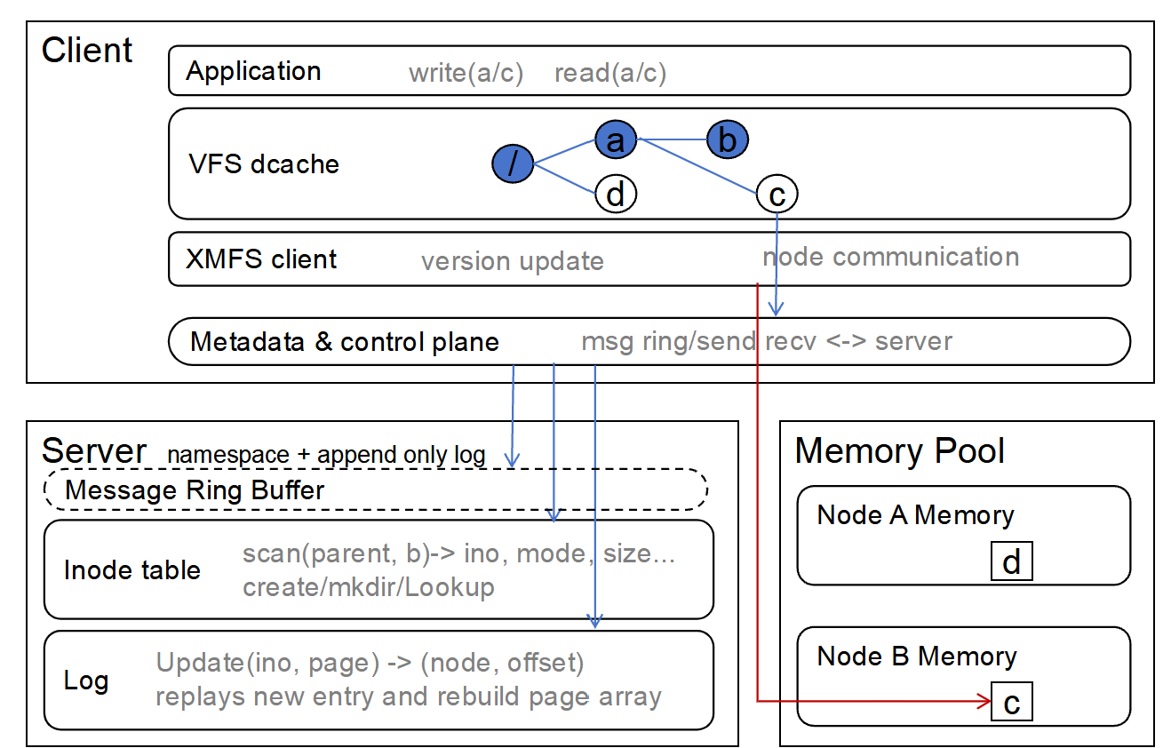
XMFS Architecture: A DFS-like kernel filesystem
Server handles metadata and space allocation
superblock(version control)
inode table
append-only log slot allocation
load balance
Client handles POSIX request and communicates to server and memory pool
replay to catchup
build inode table
write logs
Memory Pool, usually the clients’ memory, also a disaggregated device
hold data
allocate data slots
GC

Slide 8
XMFS Spec
Scale: 16 clients (and memory nodes) in this prototype.
Metadata lives on one Server (namespace + log slots). Data pages are allocated by the pool owner.
Network mode only supports URMA now. RDMA is not in this tree.
Writes are out-of-place (log-structured / COW): a write allocates new pool pages; readers keep the old mapping until they catch up. Per-owner GC reclaims.
Ordinary filesystem POSIX operations are supported.
 | Ops
File | open / read / write / lseek / mmap / fallocate / getattr / setattr
Directory | create / lookup / mkdir / rmdir / readdir / rename / link / unlink
Other | symlink / mknod / xattr (user / trusted / security) / statfs

Slide 9
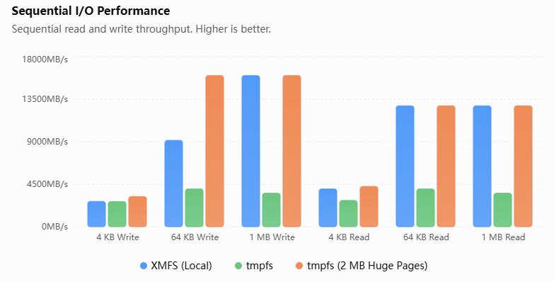
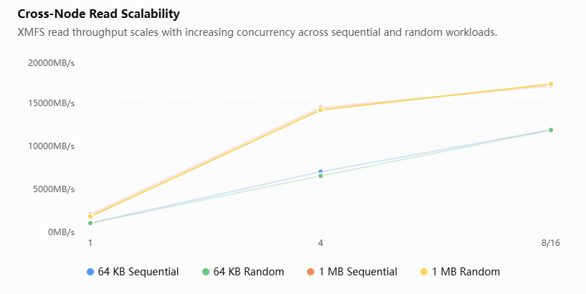
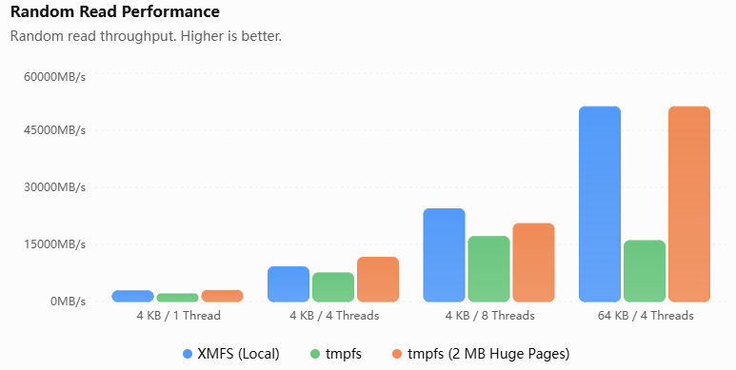
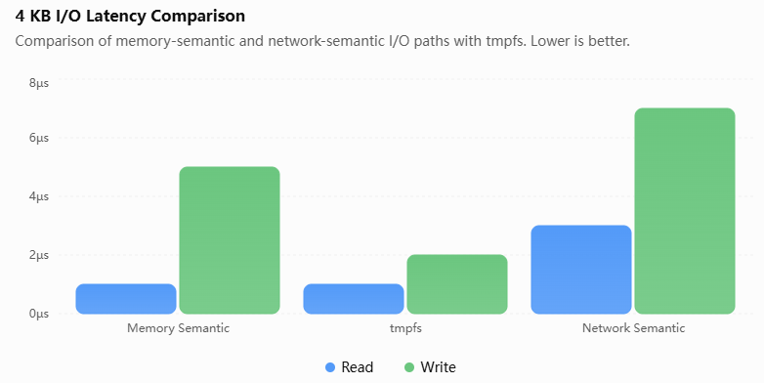
Basic performance

Slide 10
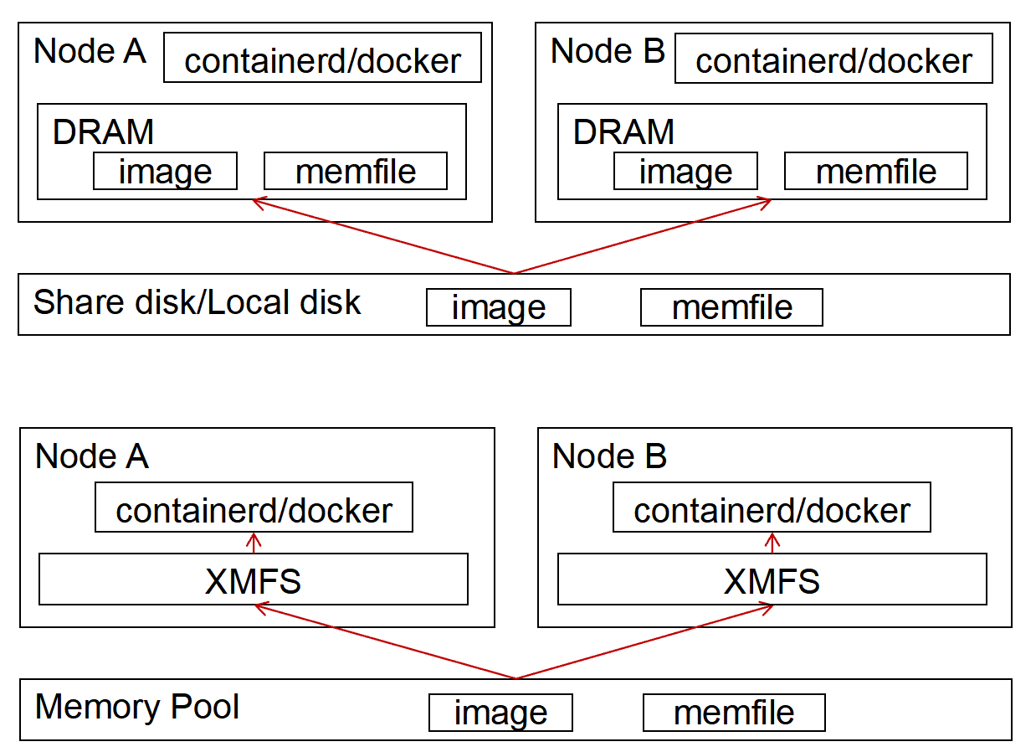
Prototype: container cold start
Read-only image share
Nodes boot the same container image. Today each node reads a local copy from disk.
XMFS keeps one image in the pool. Both nodes open the same file and LD/ST the layers — no second pull.
3.25 s -> 1.99 s vs local disk

Slide 11
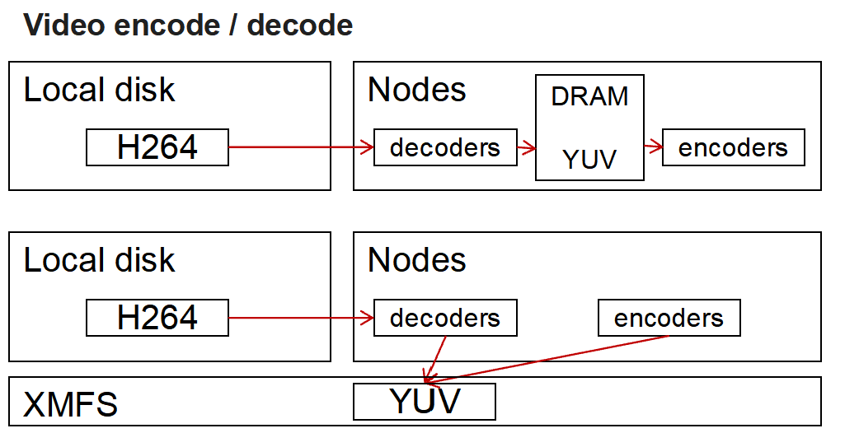
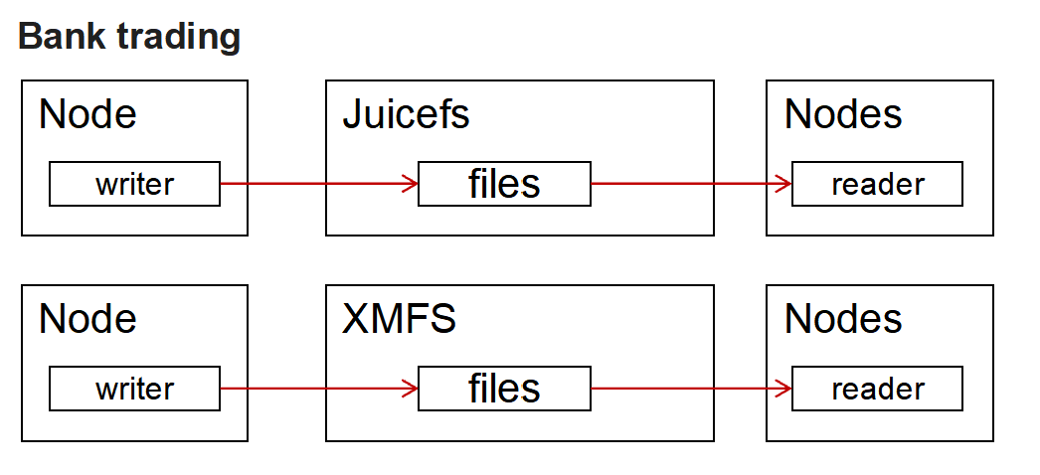
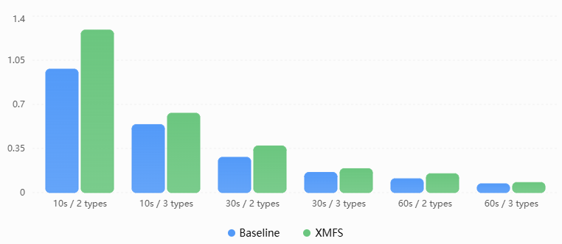
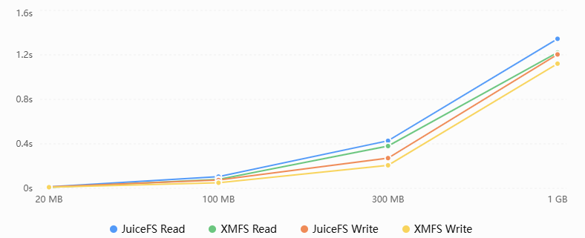
Prototype: shared pipelines
Workers decode slices; other workers encode. Baseline: each node decodes and encodes its own copy. XMFS: one decode, either node encodes the same slice.
Predecessor writes results; another node reads them. Baseline: NAS, or JuiceFS(also uses UB/URMA). Juicefs: writeback; XMFS: server load balance.

Slide 12
Future
1. Let XMFS handle the page swap between host and NPU/GPU -- offloading and sharing weights/MoE
2. Reliability: backup, fault tolerance, and failover so a Host or peer failure does not take the service down

Slide 14

UB Community Ecosystem Partnership

